Slide 1
Digital Portfolio
STUDENT NAME: VISHAL P V
REGISTER NO AND NMID: 2428C0526 &
BDD149F6541E7FD95D543C0065C6535C
DEPARTMENT: B.Sc - AIML
COLLEGE: KPR COLLEGE/ BHARATHIYAR UNIVERSITY

Slide 2
PROJECT TITLE
Sports Coach Portfolio Website.

Slide 3


AGENDA
Problem Statement
Project Overview
End Users
Tools and Technologies
Portfolio design and Layout
Features and Functionality
Results and Screenshots
Conclusion
Github Link
3/21/2024 Annual Review

Slide 4

PROBLEM STATEMENT
The primary objective of this project is to create a detailed and professional sport coach portfolio that highlights the coach’s comprehensive expertise, dedication, and impact in the field of sports coaching. This portfolio will serve as a strategic tool to present the coach’s qualifications, experience, and coaching philosophy in a clear and compelling manner. It aims to demonstrate the coach’s ability to design effective training programs, foster athlete development both physically and mentally, and build cohesive, motivated teams.

Slide 5

PROJECT OVERVIEW
Showcase the coach’s qualifications, experience, and coaching philosophy Highlight ability to design training programs and develop athletes physically and mentally Demonstrate leadership, ethical coaching, and commitment to continuous professional growth Build credibility and trust with athletes, parents, and potential employers Support career advancement and opportunities within the sports industry Using html, css,javascript.,

Slide 6

WHO ARE THE END USERS?
Potential Employers Sports clubs, schools, colleges, or professional teams looking to hire qualified coaches. Athletes and Their Parents/Guardians Athletes searching for a coach to guide their development and parents wanting assurance of the coach’s credentials and approach. Sports Organizations and Governing Bodies Organizations responsible for certifying coaches, ensuring coaching standards, or promoting professional development.

Slide 7

TOOLS AND TECHNIQUES
HTML CSS JavaScript Git and GitHub VS Code

Slide 8
PORTFOLIO DESIGN AND LAYOUT
Cover Page: Coach’s name and professional photo Coaching title/role Contact details (phone, email, website) Table of Contents: List of sections with page numbers or clickable links Coaching Philosophy: Personal coaching statement Core values and coaching approach
8

Slide 9
FEATURES AND FUNCTIONALITY
Personal Profile Section – Basic details, bio, and coaching background. Coaching Philosophy – Vision, mission, and training approach. Sports Specialization – Specific games or skills expertise. Experience Timeline – Career journey with past teams and organizations. Training Programs – Workout schedules, fitness plans, and skill drills. Player Development Records – Performance progress of trainees/athletes. Achievements & Awards – Certifications, medals, recognitions, and licenses.

Slide 10
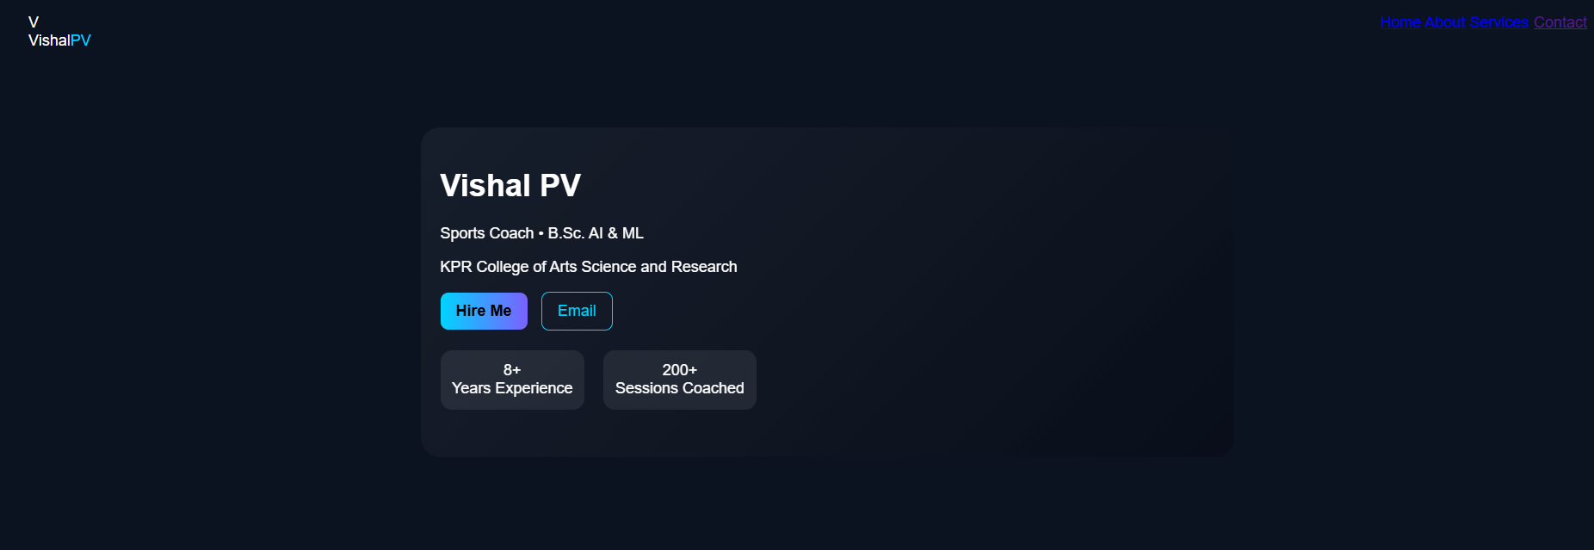
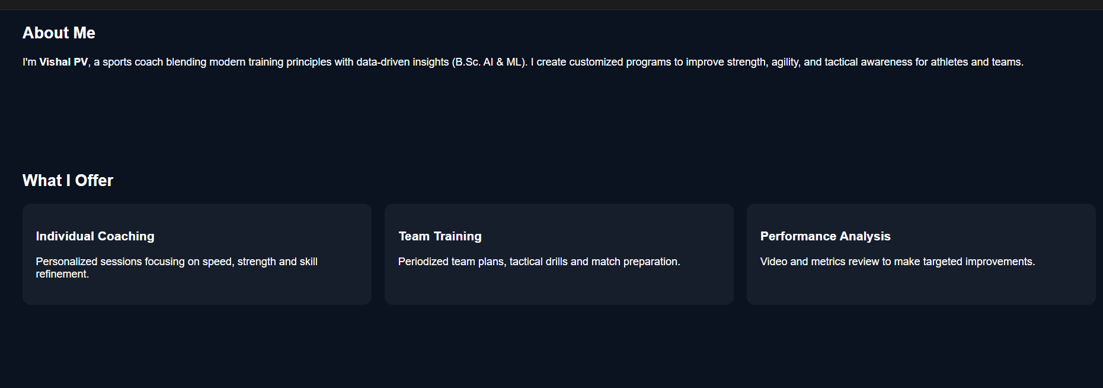


RESULTS AND SCREENSHOTS
3/21/2024 Annual Review
10

Slide 11
GITHUB LINK
https://github.com/Vishal-code-stack/vishal-portfolio.git

Slide 12
CONCLUSION
Highlights my sports skills and career achievements Summarizes my journey, milestones, and dedication to the game Helps coaches, teams, and sponsors understand my potential Makes it easier for scouts, managers, and supporters to connect with me
12

